Slide 1
Fake news
created by James Taylor
www.theteacherjames.com

Slide 2
What is news?
with your partner, Write a definition of news
“A printed, broadcast or digital report of factual information about important events in the world, country or local area.”

Slide 3
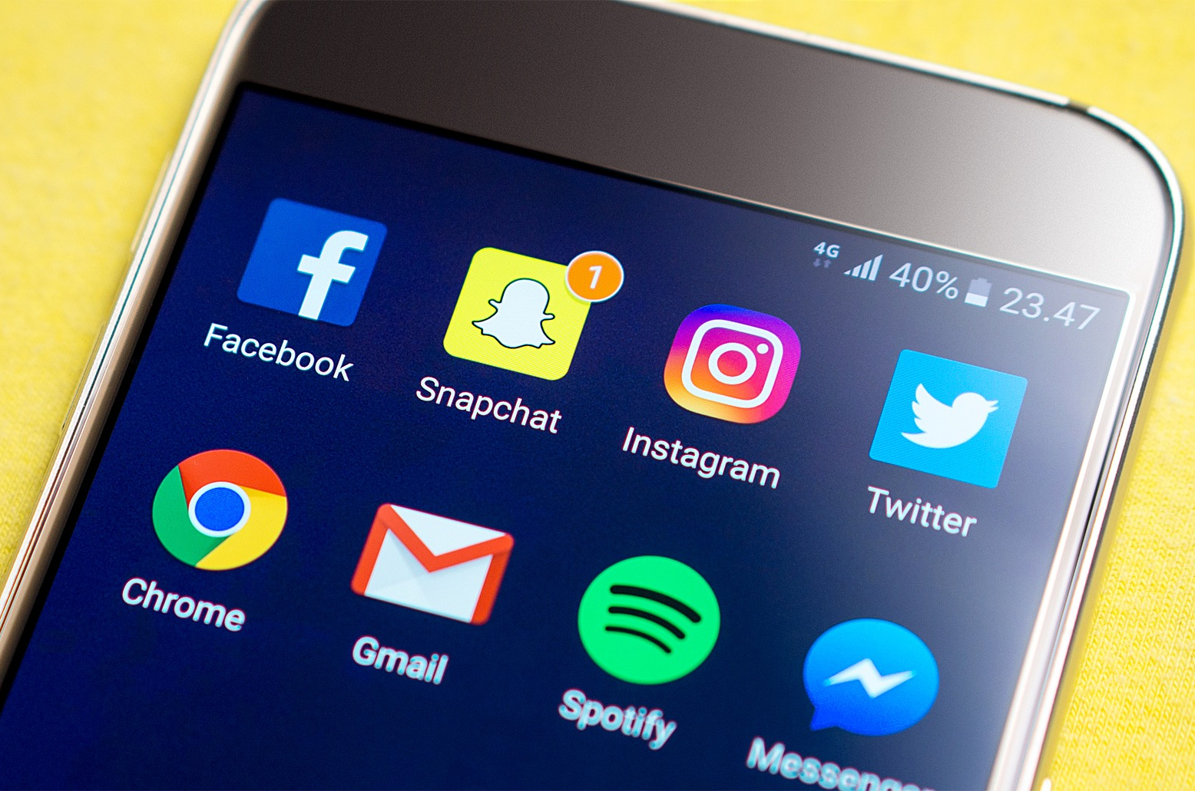
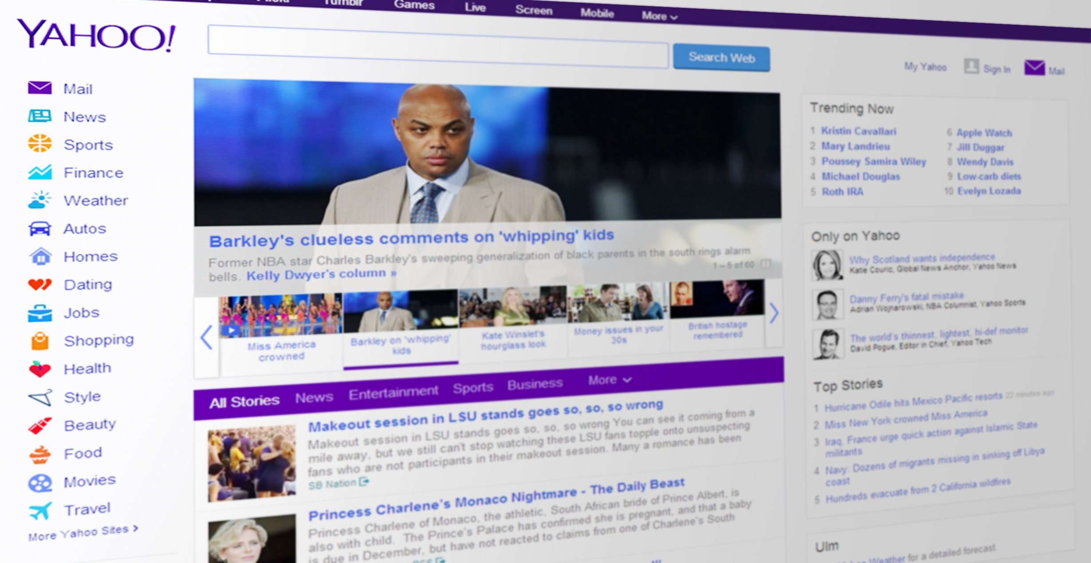
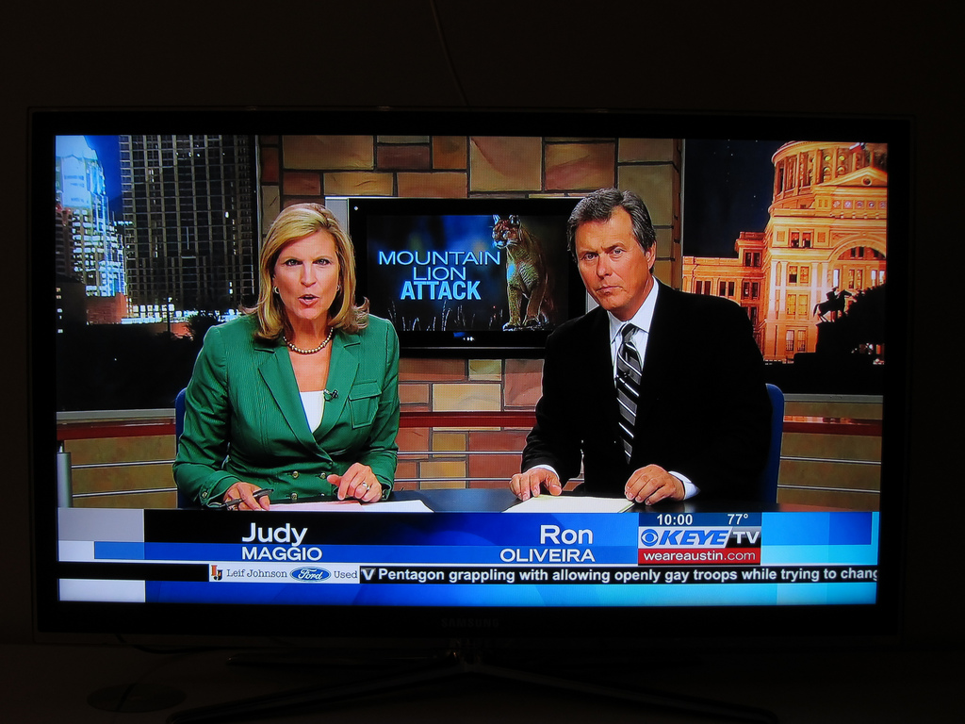
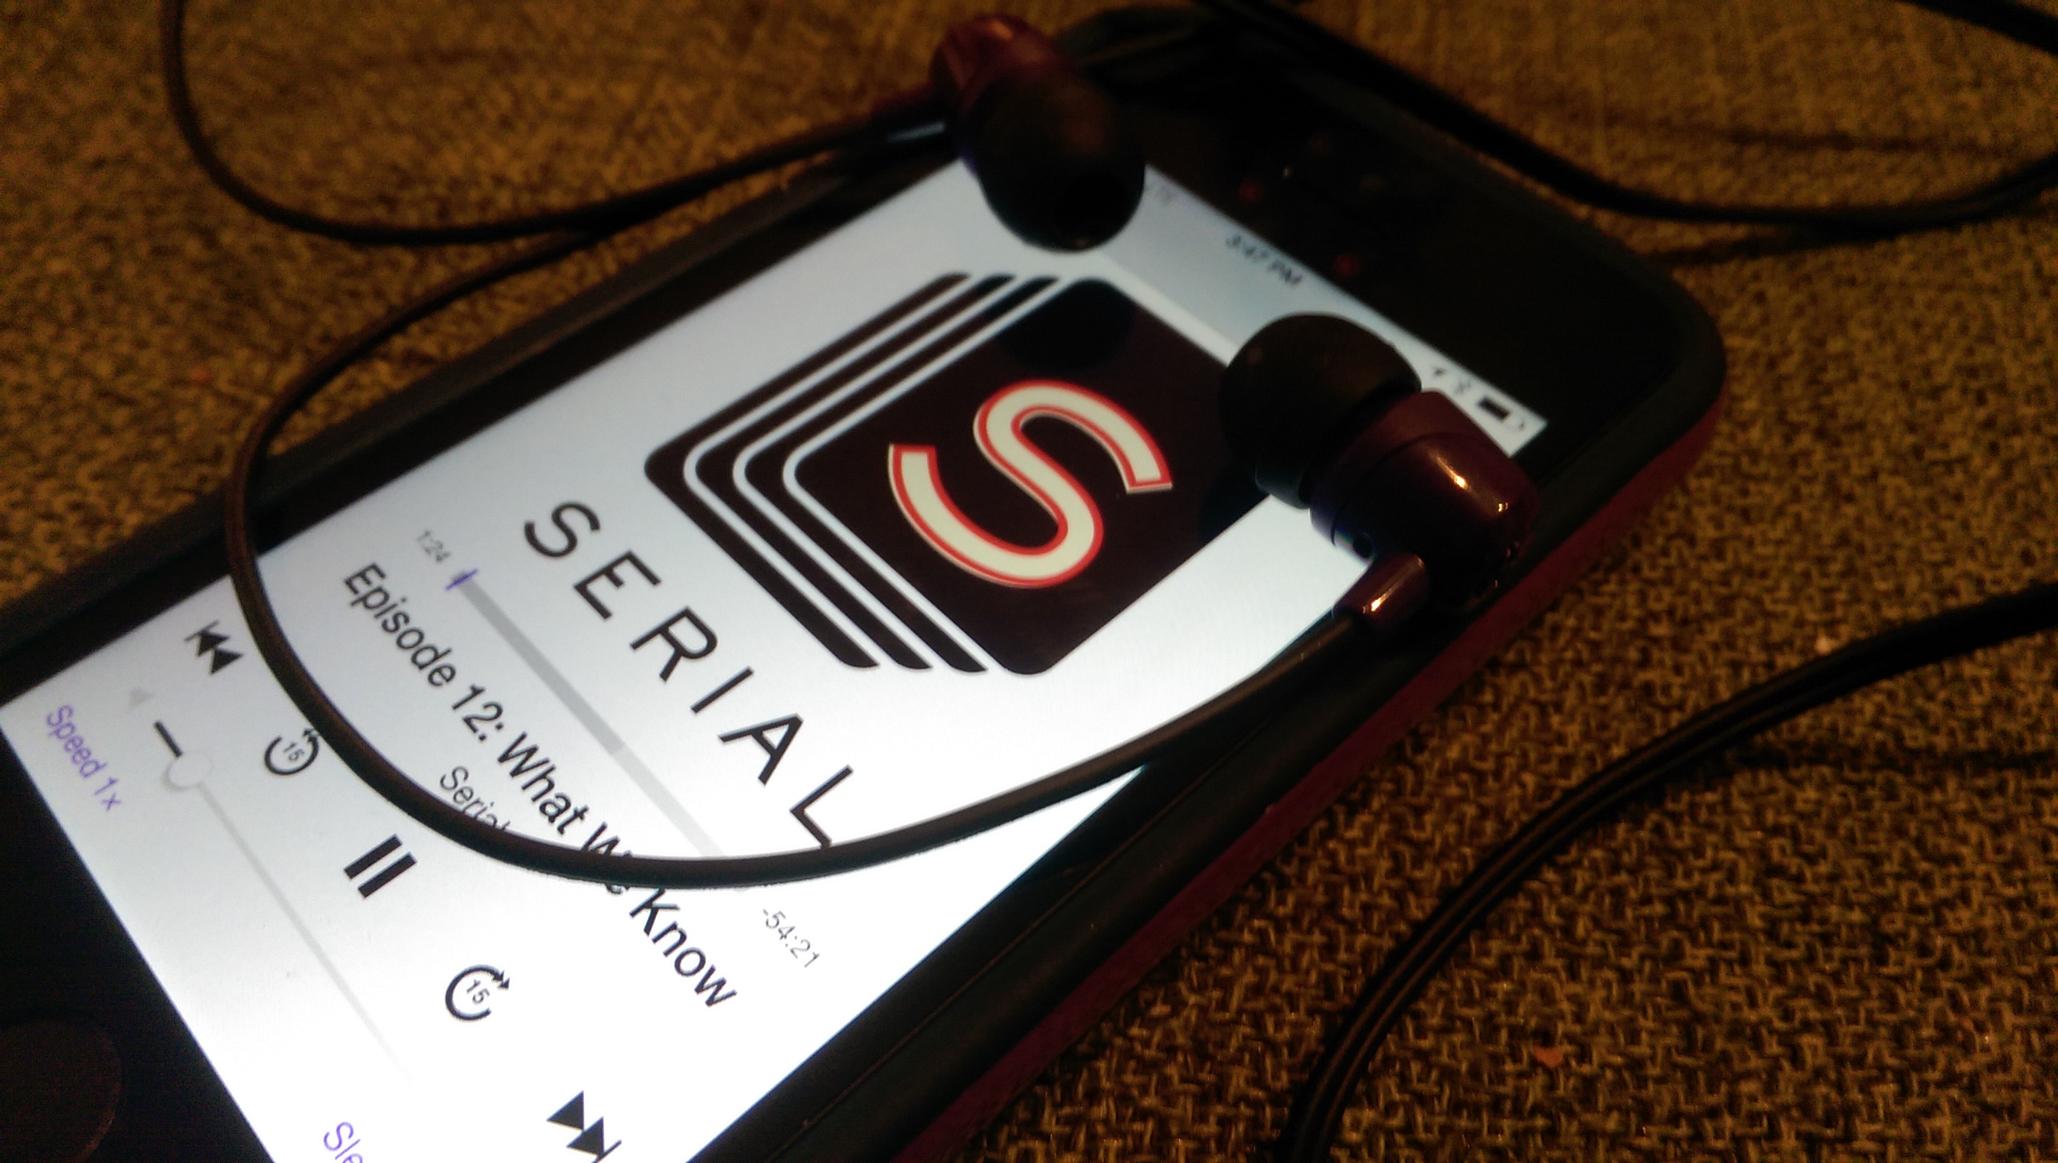

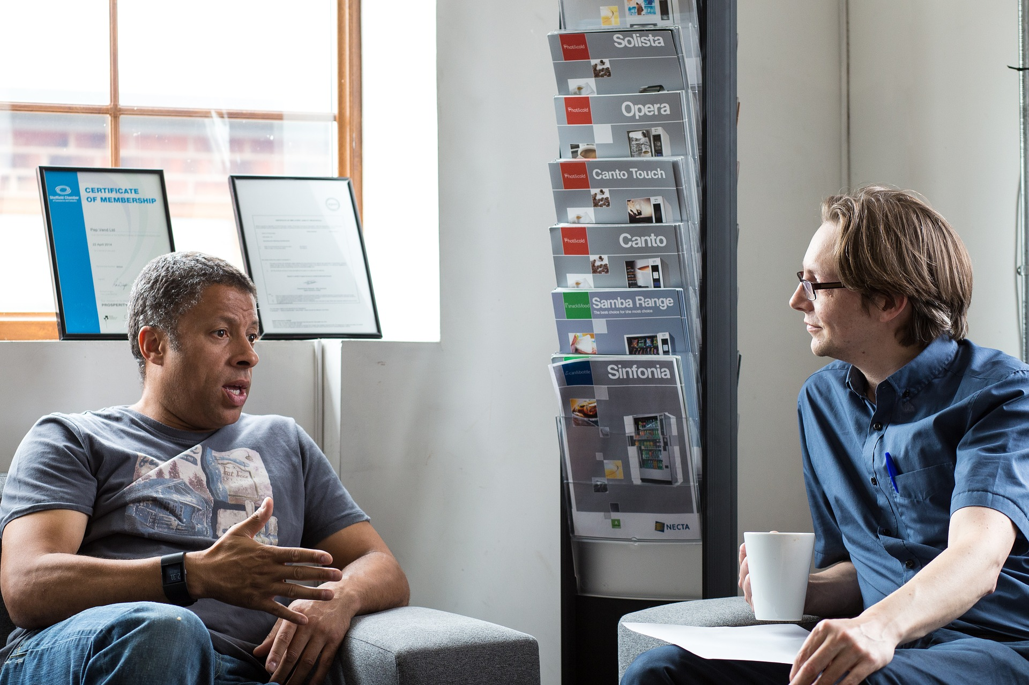
Where do you get your news?
Discuss the advantages and disadvantages of your favourite news source.

Slide 4

What is fake news?
What is a fake news site?
Why do people publish fake news?
What’s the connection with social media?

Slide 5
Fake or real?
Go to http://zapatopi.Net/treeoctopus/ and make a list of reasons why this website could be real or could be fake

Slide 6

Fake or real?
Make a list of reasons why you think it might be real and might be fake.

Slide 7
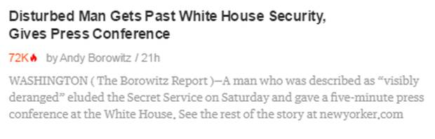
Fake or real?
Make a list of reasons why you think it might be real and might be fake.

Slide 8
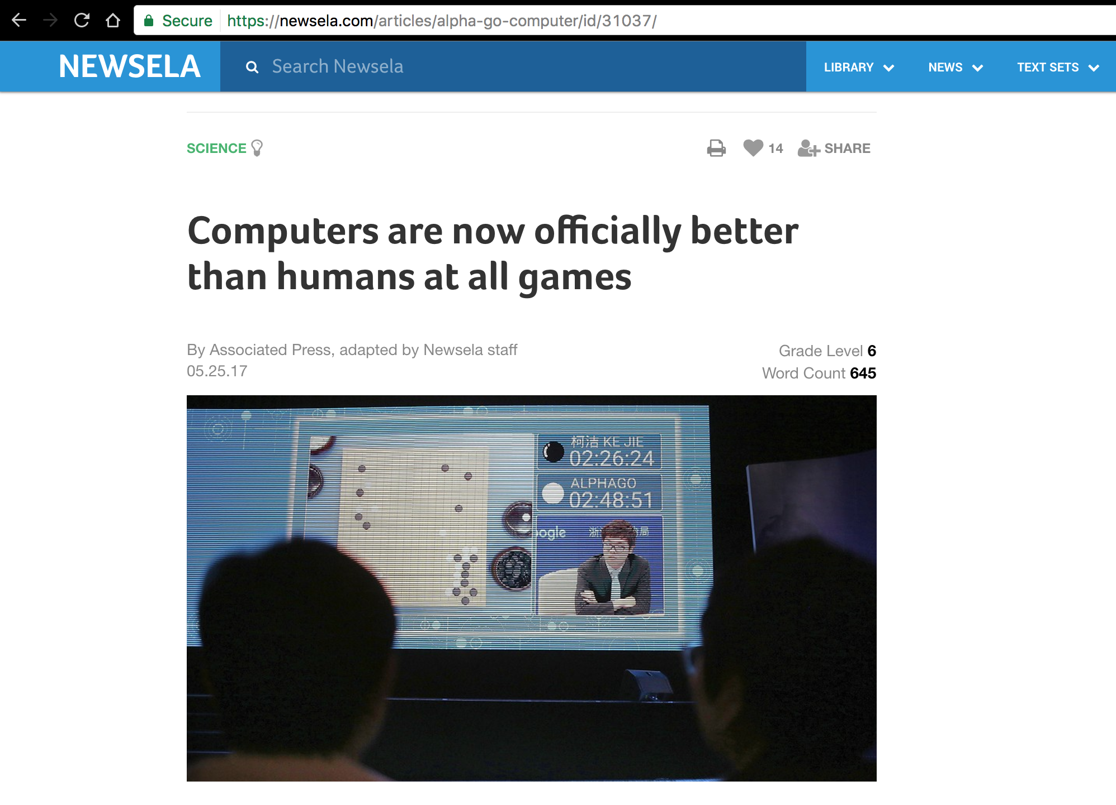
Fake or real?
Make a list of reasons why you think it might be real and might be fake.

Slide 9
Discuss
Was it easy or difficult to determine whether the news was fake or real? Please explain.
What were some clues that the news was not true?
How did you feel when you found a news story was fake if you originally thought it was real?

Slide 10
How to spot fake news
Watch the video and make a list of the strategies they mention to spot fake news.
Consider the source
Read beyond the headline
Check the author
What’s the support?
Check the date
Is this some kind of joke?
Check your biases
Consult the experts

Slide 11




Fact-checking sites

Slide 12
Discuss
What have you learned today?
Will this change the way you look at news in the future?
Do you think people in your society are good are finding fake news?
Do you think we rely too much on social media for our news?
What can we do about fake news? What can we do individually and what might we do with others in our school or larger community?

Slide 13
Credit
This lesson plan was created by James Taylor at www.theteacherjames.com. It is adapted from a lesson plan by the Anti Defamation League (www.Adl.Org/sites/default/files/documents/assets/pdf/education-outreach/fake-news-and-what-we-can-do-about-it.Pdf) with elements taken from (www.Readwritethink.Org/classroom-resources/lesson-plans/hoax-hoax-strategies-online-1135.Html?Tab=4)
Video source: How to spot fake news - factcheck.Org (https://youtu.be/AkwWcHekMdo)
For more lesson plans, activities and opinion pieces, go to
www.theteacherjames.com

