Slide 1
Conversation starters
Created by James Taylor
www.theteacherjames.com

Slide 2
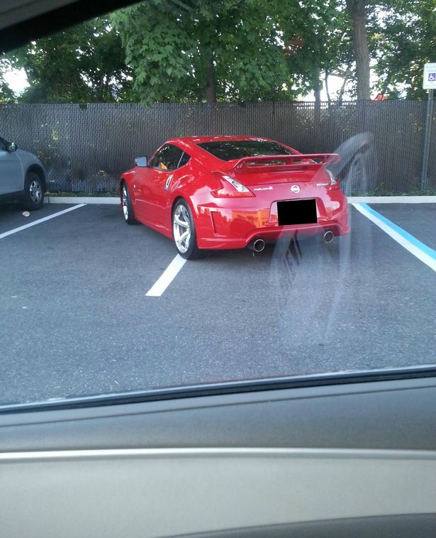
What would you say to this person if you could speak to them?
Why did they park like this?
Is there any good reason for parking this way?
If you saw this person coming back to their car, would you say anything to them? Do you think we should?
Which words would you use to describe this person’s personality?
What social issues does this picture make you think of?

Slide 3
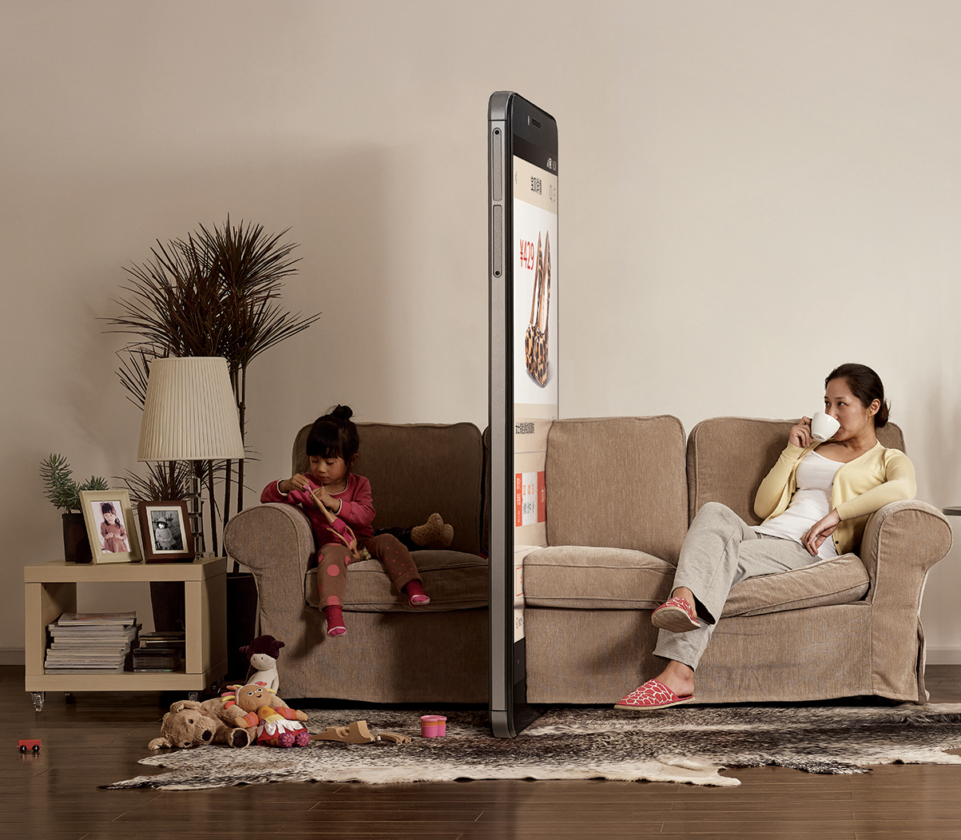
What is the message of these pictures?
Do you agree with this message?
Do you think that mobile technology has made the world better or worse? Why? Discuss the different ways thing have got better and worse.
What is your relationship with technology?
Do you thing it’s possible to get the balance between enjoying devices and overusing them?
What would you say to the people in these photos?

Slide 4
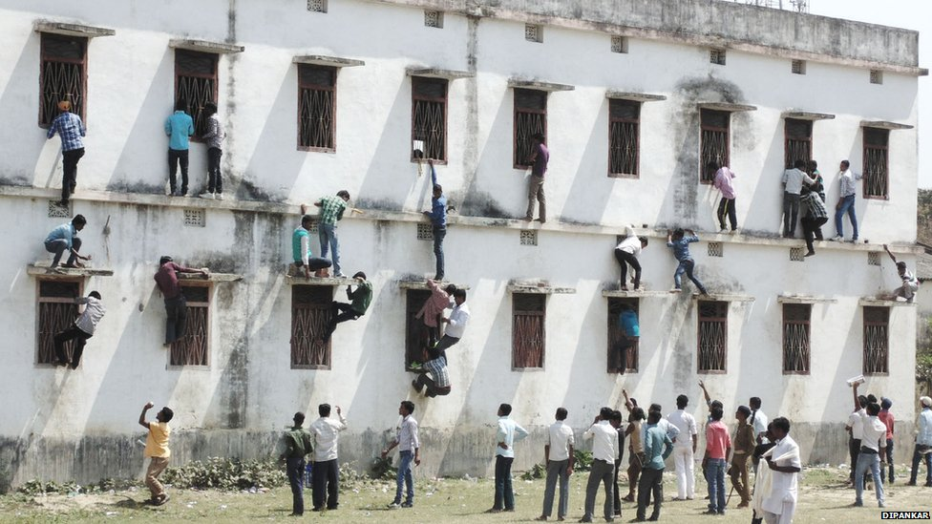
What do you think is happening here?

Slide 5
What does this tell you about education in India?
Does this compare with your country?
Is it ever acceptable to cheat on an exam?
What’s your most memorable experience of taking an exam?
Do you think that exams are a good way to judge academic achievement or are there better ways?
What would you say to the people in these photos?

Slide 6

What is the message behind this image?
Do you agree with this message?
Do you think people are knowledgeable about what they eat? Why?
Do you worry about what you eat?
Do you believe in food trends like organic or gluten-free?
Do you think that the public are scientifically literate in general?

Slide 7
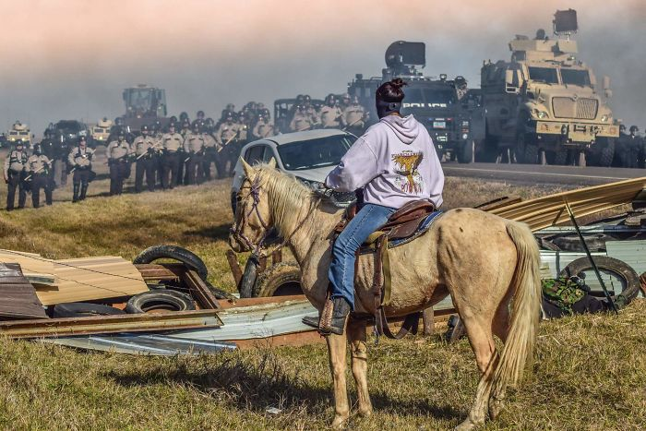
Where do you think this photo was taken? Why
What qualities do you think this picture represents? Do you think protest is important?
Have you ever been on a protest? Why (not)?
Which words would you use to describe this picture?
If you could talk to the people in the photo, what would you say?

Slide 8
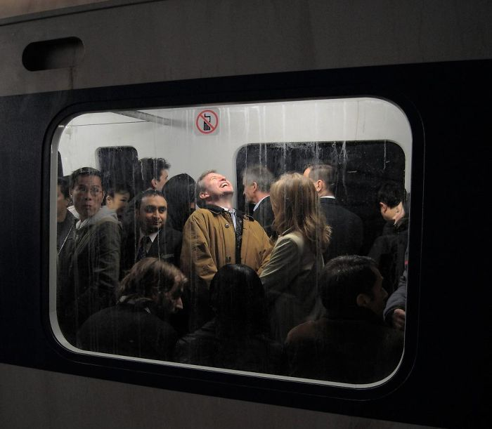
Why do you think he is laughing?
What do you think the other passengers are thinking?
Who do you identify with – the man or the passengers?
Do you think this is a good photo?
How important is laughter in our lives?
How do you feel about commuting?

Slide 9
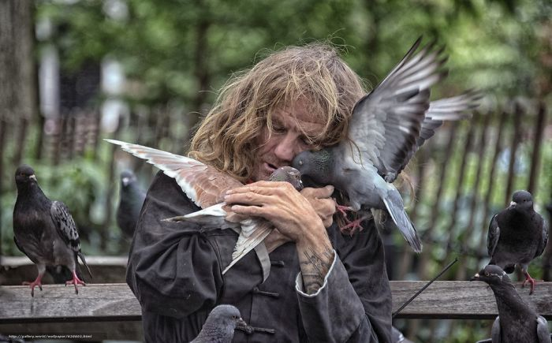
How does this photo make you feel?
Summarise the message behind the photo.
Where do you think the man comes from? What’s his story?
Do you think it’s a good photograph? Why?
If you could speak to the man, what would you say?

Slide 10
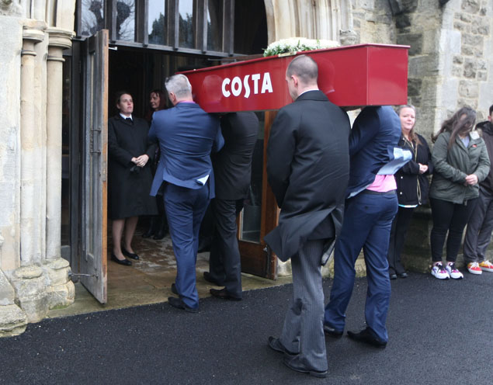
What do you think is happening here?

Slide 11
What do you think is happening here?
What do you think about this picture?
Are you very loyal to a specific company?
If you could speak to the woman in the coffin, what would you say? How do you think she would answer?
If you could speak to her family friends, what would you say? How do you think she would answer?

Slide 12

What do think is happening in this picture?

Slide 13
What do think is happening in this picture?
How does it make you feel?
What do you think the photographer was trying to communicate?
What do you think the people on the fence are thinking?
What about the golfers?

Slide 14
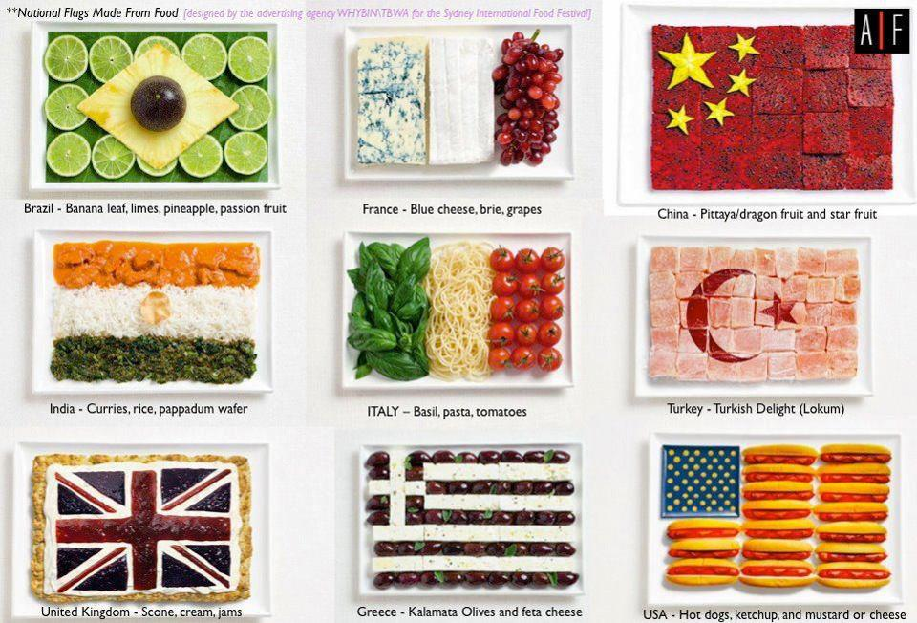
Is food a big part of your culture?
Do you prefer food from your culture or international food? Which country’s food is your favourite?
If you were going to take a foreigner to a typical restaurant in your country, what would you feed them?
If your country isn’t represented here, what foods would you use to in your flag?
If your country is here, are you happy with the choice they made?

Slide 15
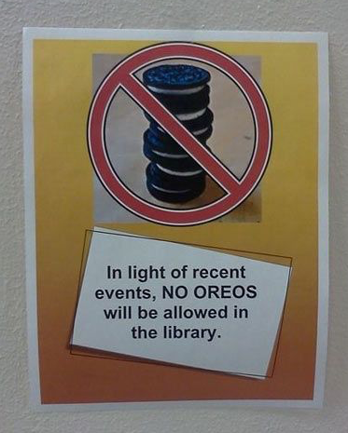
Why did someone make this sign? Create a story behind what happened.

Slide 16

What do you think of these ideas?
Do you ever do random acts of kindness?
How important is it for strangers to be kind to each other?
Do you think this is common in your society?
Do you have any of your own ideas that you would add to the poster?
If you had to try one of these tomorrow, which one would you do?

Slide 17
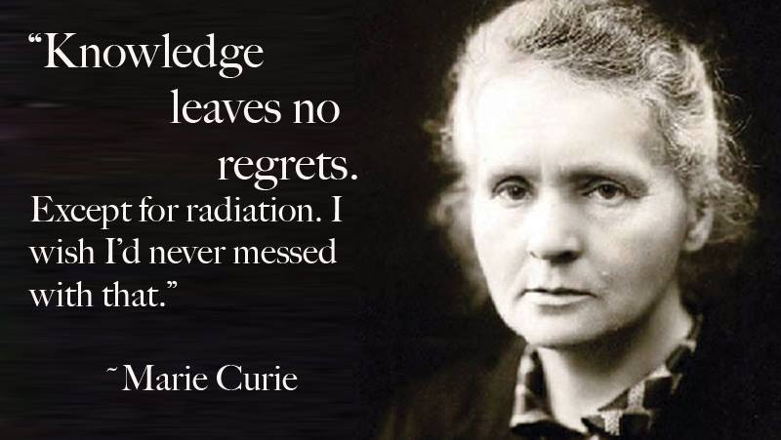
What do you think of this quote?
When you see things on the Internet, do you ever check to see if they are true?
Do you think that there is a problem in society with people just believing what they see online?
Do you think that these skills should be taught in school?

Slide 18
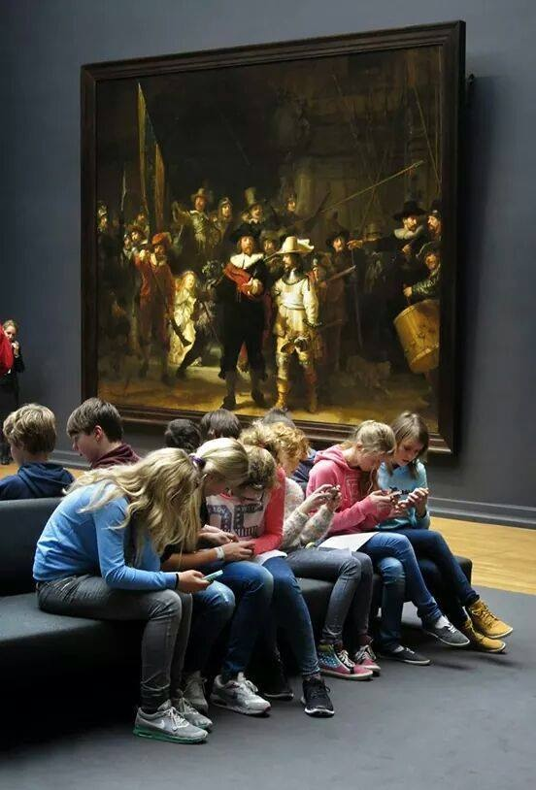
How does this photo make you feel?
If you could speak to these teenagers, what would you say to them?
Is there any possible positive reason for what is happening in the picture?
Do you think modern technology makes it more difficult for teenagers to appreciate offline entertainment?
Is there any place where you would ban mobile devices?

Slide 19
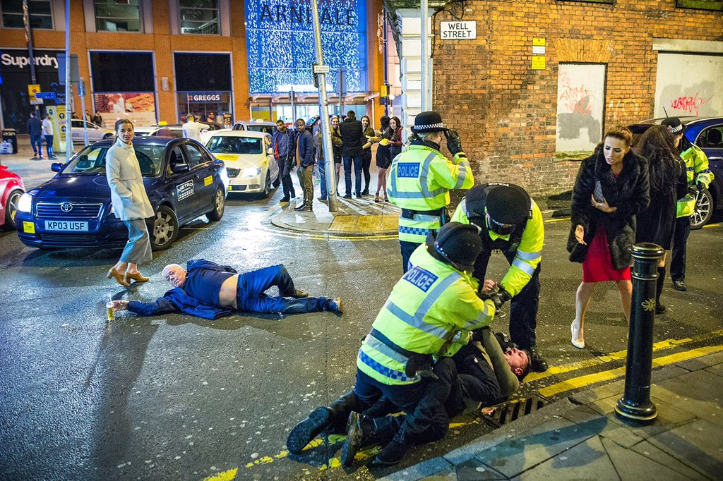
What do you think is happening in this picture?
Where do you think it was taken?
What impression does it give you of the society where it was taken?
Is it possible to see a scene like this in your city?
What can be done to prevent these kinds of scenes?

Slide 20
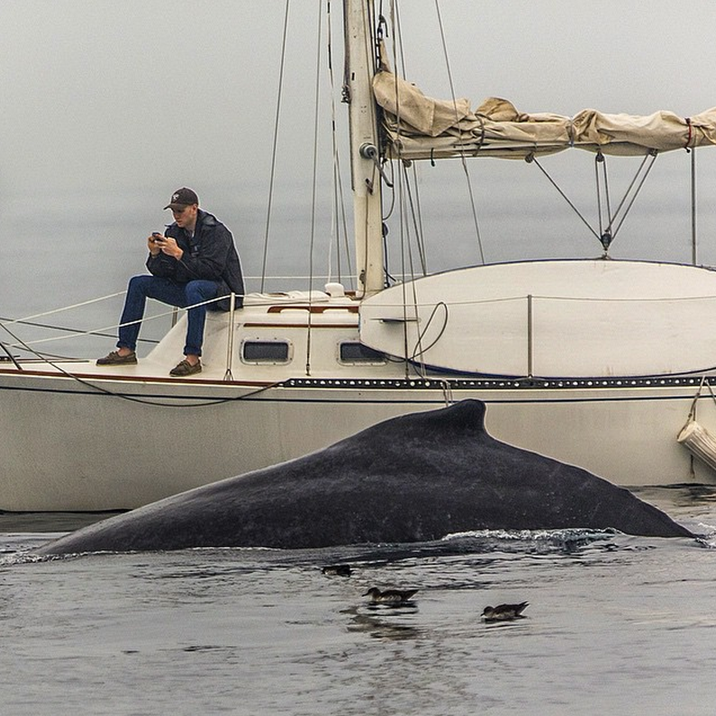
What do you think is happening here?
How would you describe the man’s personality based on this picture?
Is there any possible excuse for this?
If you could speak to him, what would you say? How do you think he would respond?
Do you ever get distracted by technology?

Slide 21
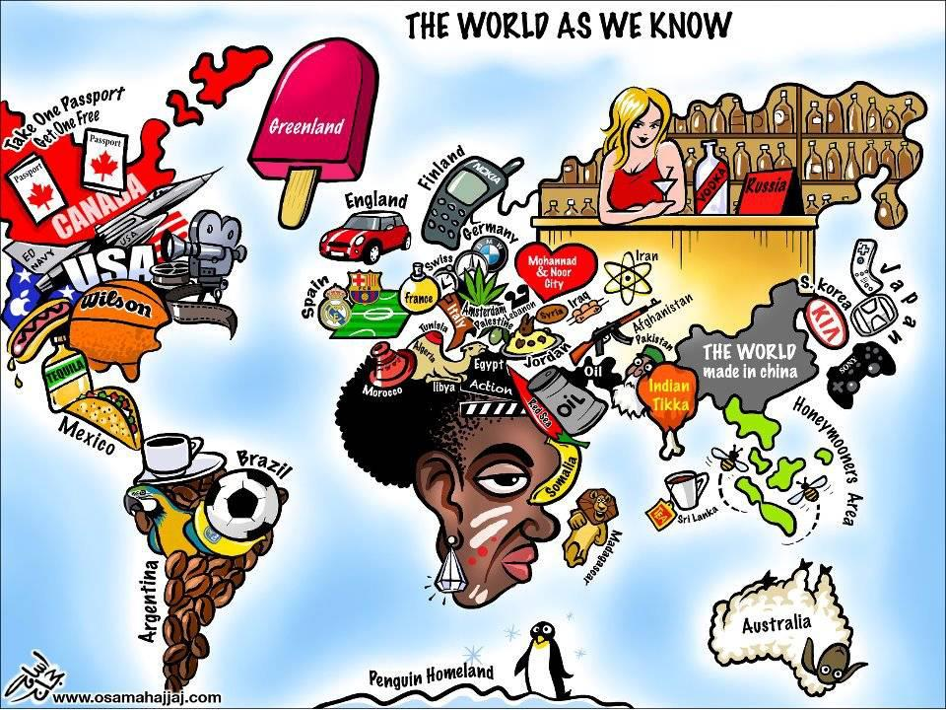
How do you feel about how your country is represented here?
Is there any truth to national stereotypes?
Do you think this is offensive or just fun?
Which country or continent should be most upset with their portrayal, in your view?
If you could portray your country in a positive way, what images would you choose?

Slide 22
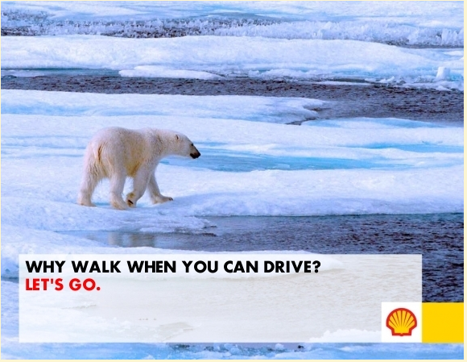
What do you think the message of this advert is?
Who do you think created it?
Is it effective?

Slide 23
What do you think the message of this advert is?
Who do you think created it?
Is it effective?
How do you think Shell feel about it?
How effective is this kind of satire, in your view?
How important is it for people to satirise big corporations and governments?
Do you think this is a good time for satire?

Slide 24
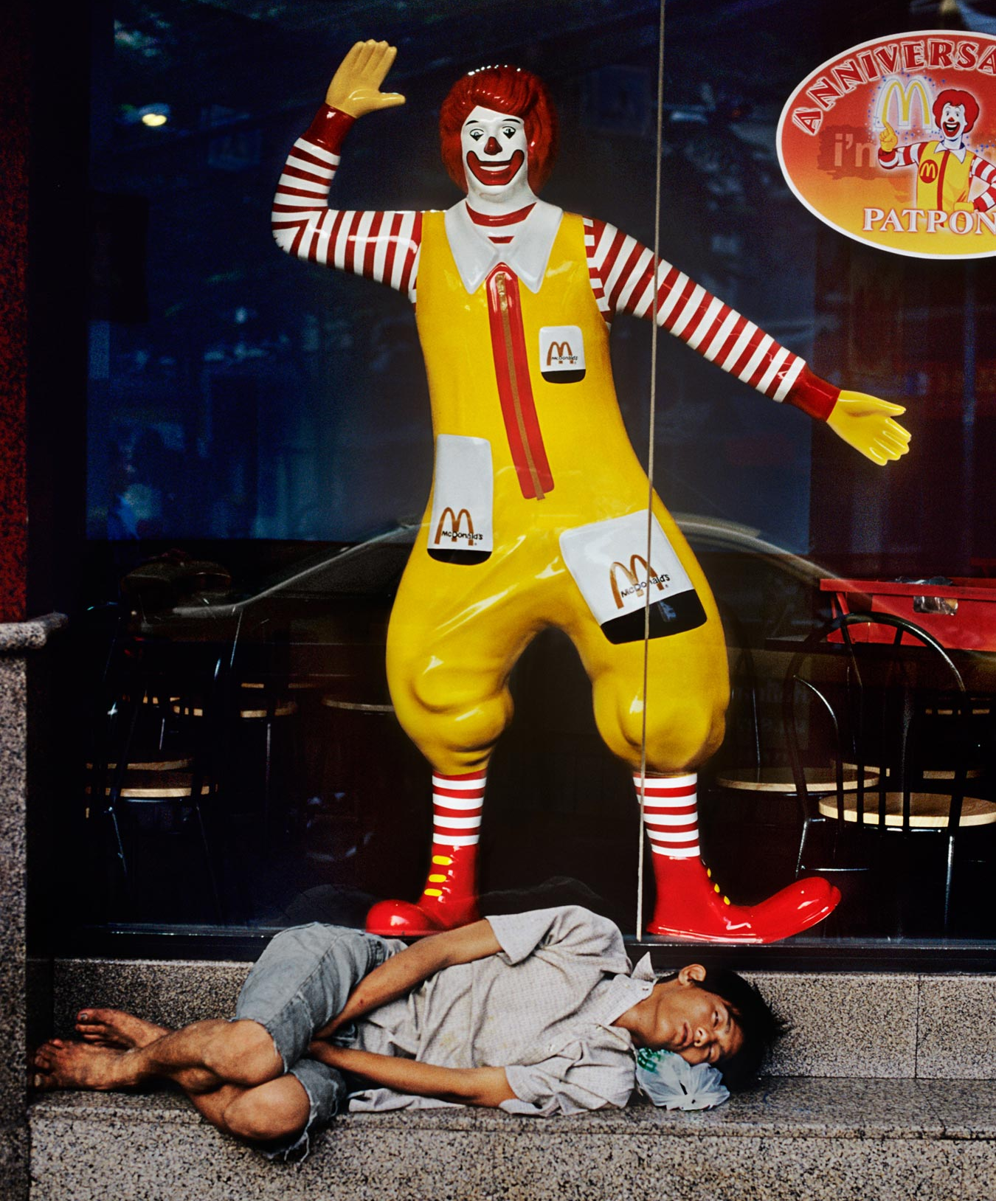
What do you think the photographer took this photo?
Is it effective?
How do you think McDonalds feel about it?
How effective is this kind of photography, in your view?
How important is it for people to criticise big corporations and governments?
How would you solve homelessness?

Slide 25
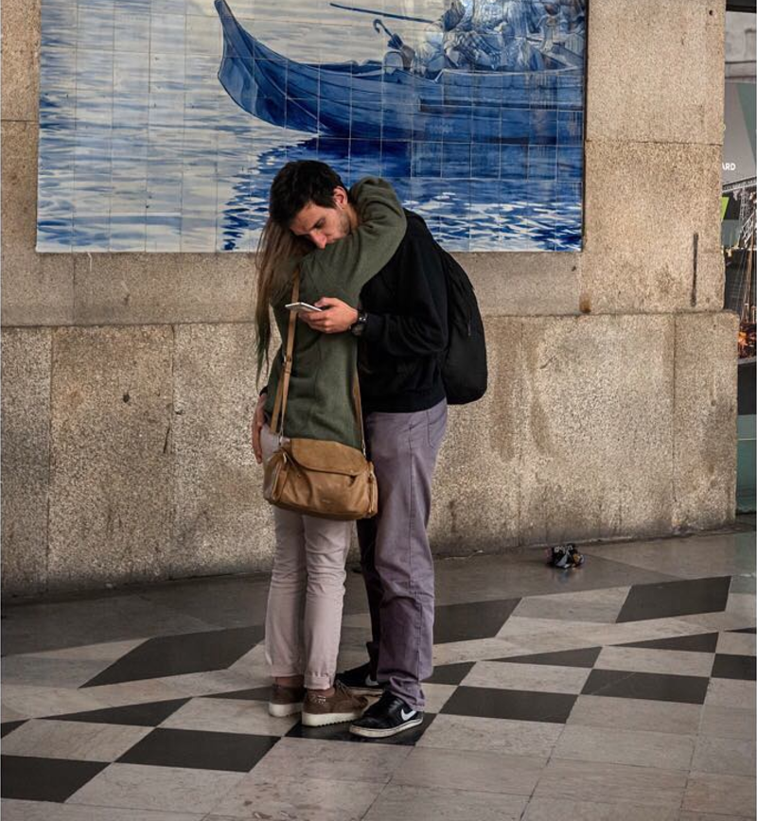
How would you describe what is happening here?
How would you describe the man’s personality based on this picture?
Is there any possible excuse for this?
What do you think she should say to him? How do you think he would respond?
Do you ever get distracted by technology?

Slide 26
Created by James Taylor
For more lesson plans, resources and opinion pieces go to: www.theteacherjames.com

