Slide 1
Seven word biography
Created by james taylor
www.theteacherjames.com

Slide 2
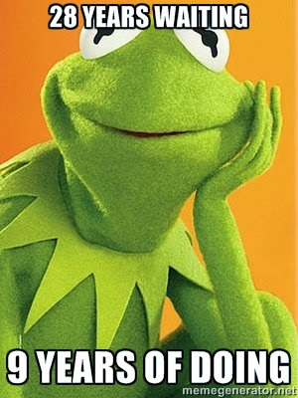

Slide 3
Famous peoples’ seven word biographies
Jim Holt - Failed mathematician who happily declined into journalism.
David Byrne - unfinished, unprocessed, uncertain, unknown, unadorned, unsettled, unfussy
Daniel Kahneman - Endlessly amused by people’s minds
Brian Eno - I like making and thinking about culture.
Malcolm Gladwell - Father said: “Anything but journalism.” I rebelled.
Rufus Wainwright - According to Elton John world’s greatest singer-songwriter
Don DeLillo - Bronx boy wondering why he is here.
Anish Kapoor - As if to celebrate I discovered a mountain
Joan Didion - Seven words do not yet define me.

Slide 4

Your turn!
memegenerator.net

Slide 5
Sources
www.brainpickings.org/index.php/2013/07/11/nypl-live-holdengraber-7-word-bios/

Slide 6
Teacher notes
Write your own seven word biography and put it on the board. Ask the students to discuss in pairs what they think I mean by this.
Give out one seven word biography per student or in pairs. Ask them to read it and think about what it could mean. If in pairs, get them to discuss it, and if not, ask them to share with a partner.
From the biography, try and guess what the person does for a job (some of them are fairly easy, but you could ask them to try and be more specific i.e. what kind of journalist is Malcolm Gladwell? What do you think he writes about?)
Ask them to check online and find out more about the person. Ask them to write down four key facts about the person so they can describe them to the rest of the class.

Slide 7
Teacher notes
They can now read their biographies to the rest of the class, and they can guess what job the person does. The students can then answer by using the facts they wrote down.
Talk about the different styles of biography (Eno and Wainwright's are very straight descriptions, Didion, Holt, DeLillo, Gladwell and Kahneman's are clever or funny, and Kapoor and Byrne's are abstract and poetic.) Point out how some of them skip parts of the language (pronouns, articles, to be etc), some of them are lists and some are complete sentences.
Ask students to write their own seven word biographies. As they work on them, make yourself available to help, and check to make sure they are correct.
Ask them to write the seven word biography in big letters on a piece of A4 paper so they are clear to read (if you have the facilities, you could use a website like memegenerator.net to make them into attractive images, like I did above). Stick them up around the class so everyone can read them. Give the other students an opportunity to ask questions to the writers so they can expand on what they've written.

Slide 8
For more lesson plans, activities and opinion pieces, go to
www.theteacherjames.com

